Slide 1
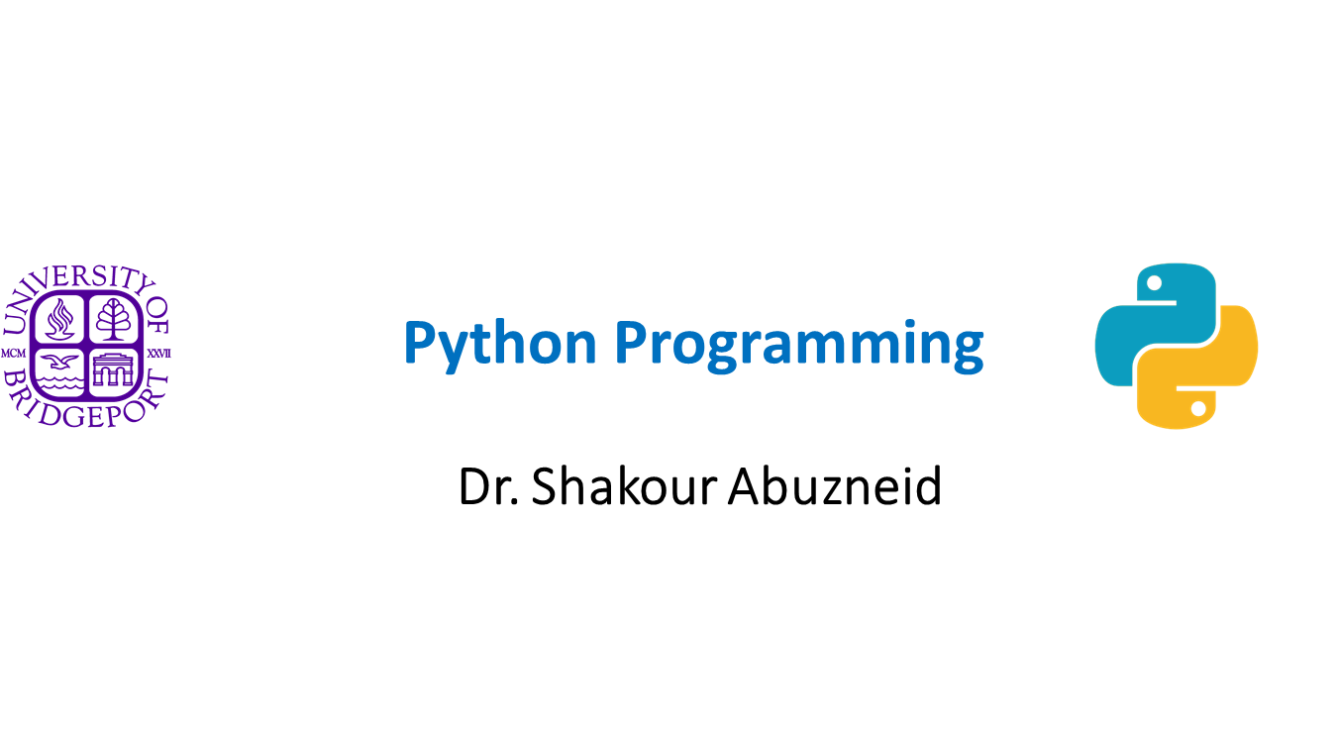

Slide 2
Python Network Programming

Slide 3
Topics
Introduction
What Is Client/Server
Architecture?
Sockets: Communication Endpoints
Network Programming in Python
The SocketServer Module
Introduction to the Twisted Framework
Related Modules

Slide 4
What is Client/Server Architecture?
server—a piece of hardware or software—provides a “service” that is needed by one or more clients (users of the service).
wait for (client) requests, respond to those clients (provide the service), and then wait for more requests.

Slide 5
Hardware Client/Server Architecture
Print(er) servers are examples of hardware servers.
A file server.
Sun Microsystems’Network File System (NFS).

Slide 6
Software Client/Server Architecture
Software servers also run on a piece of hardware but do not have dedicated peripheral devices.
The primary services provided by software servers include program execution, data transfer retrieval, aggregation, update, or other types of programmed or data manipulation.
Example: Web servers.
The job of such a server is to accept client requests, send back Web pages to (Web) clients, that is, browsers on users’ computers, and then wait for the next client request.
Database servers are another kind of software server.
Windows servers.

Slide 7
Client/Server Network Programming
A communication endpoint is created which allows a server to listen for requests.
Once a communication endpoint has been established, our listening server can now enter its infinite loop, waiting for clients to connect, and responding to requests.
All the client has to do is to create its single communication endpoint, and then establish a connection to the server.
The client can now make a request, which includes any necessary exchange of data.
Once the request has been processed and the client has received the result or some sort of acknowledgement, communication is terminated.

Slide 8
Sockets: Communication Endpoints
Sockets are computer networking data structures that embody the concept of the “communication endpoint”.
Sockets were originally created for same-host applications where they would enable one running program (a.k.a. a process) to communicate with another running program (interprocess communication, or IPC).
Two types of sockets:
File-based and,
Network-oriented
Python supports only the following families:
AF_UNIX,
AF_NETLINK,
AF_TIPC,
AF_INET{,6}

Slide 9
File-based Sockets
“family name” of AF_UNIX.
AF_LOCAL, as specified in the POSIX1.g standard.
Python, use the term address families and the abbreviation AF.
AF_LOCAL (standardized in 2000–2001) is supposed to replace AF_UNIX.
Python for backward-compatibility use both.
Because both processes run on the same computer, these sockets are file-based, meaning that their underlying infrastructure is supported by the file system.
File system is a shared constant between processes running on the same host.

Slide 10
Networked-based Socket
AF_INET, or address family: Internet. The most widely used.
AF_INET6, is used for Internet Protocol version 6 (IPv6) addressing.
The AF_NETLINK family of (connectionless) sockets allow for IPC between user and kernel-level code using the standard BSD socket interface.
The Python support AF_TIPC family. Transparent Interprocess Communication (TIPC) is used to allow clusters of computers to “talk” to each other without using IP-based addressing.

Slide 11
Socket Addresses: Host-Port Pairs
If a socket is like a telephone jack—a piece of infrastructure that enables communication—then a hostname and port number are like an area code and telephone number combination.
An Internet address is comprised of a hostname and port number pair.
Valid port numbers range from 0–65535, although those less than 1024 are reserved for the system.
A list of well-known port numbers is accessible at this Web site: http://www.iana.org/assignments/port-numbers

Slide 12
Connection-Oriented Sockets
A connection must be established before communication.
Virtual Circuit or Stream Socket.
Offers sequenced, reliable, and unduplicated delivery of data, without record boundaries.
Each message may be broken up into multiple pieces, which are all guaranteed to arrive at their destination, put back together and in order, and delivered to the waiting application.
The primary protocol is the Transmission Control Protocol (TCP).
Socket Type: SOCK_STREAM
(AF_INET) use the Internet Protocol (IP) to find hosts in the network (TCP/IP).

Slide 13
Connectionless Sockets
No connection is necessary before communication can begin (datagram).
Datagrams do preserve record boundaries → entire messages are sent rather than being broken into pieces.
So with all this negativity, why use datagrams at all?
Datagrams do not have this overhead for setup as well as in maintaining the virtual circuit connection.
Socket Type: SOCK_DGRAM.
General name: UDP/IP.

Slide 14
socket() Module Function
To create a socket, you must use the socket.socket() function:
socket(socket_family, socket_type, protocol=0)
The socket_family is either AF_UNIX or AF_INET
socket_type is either SOCK_STREAM or SOCK_ DGRAM
The protocol is usually left out, defaulting to 0.
So to create a TCP/IP socket, you call socket.socket() like this:
tcpSock = socket.socket(socket.AF_INET, socket.SOCK_STREAM)
To create a UDP/IP socket you perform:
udpSock = socket.socket(socket.AF_INET, socket.SOCK_DGRAM)

Slide 15
Importing the socket module
from socket import *
We bring the socket attributes into our namespace, but our code is shortened considerably.
Example:
tcpSock = socket(AF_INET, SOCK_STREAM)

Slide 16
Common Socket Object Methods and Attributes

Slide 17
Common Socket Object Methods and Attributes

Slide 18
Common Socket Object Methods and Attributes

Slide 19
Creating a TCP Server

Slide 20
Creating a TCP Server
All sockets are created by using the socket.socket() function.
Servers need to “sit on a port” and wait for requests, so they all must bind to a local address.
TCP servers must “listen” for (incoming) connections.
Once this setup process is complete, a server can start its infinite loop.
A simple (single-threaded) server will then sit on an accept() call, waiting for a connection.
By default, accept() is blocking, meaning that execution is suspended until a connection arrives.

Slide 21
Creating a TCP Server
Once a connection is accepted, a separate client socket is returned (by accept()) for the upcoming message interchange.
When an incoming request arrives, a new communication port is created to converse directly with that client, again, leaving the main port free to accept new client connections.
Once the temporary socket is created, communication can commence, and both client and server proceed to engage in a dialog of sending and receiving, using this new socket until the connection is terminated.
Termination usually happens when one of the parties either closes its connection or sends an empty string to its counterpart.

Slide 22
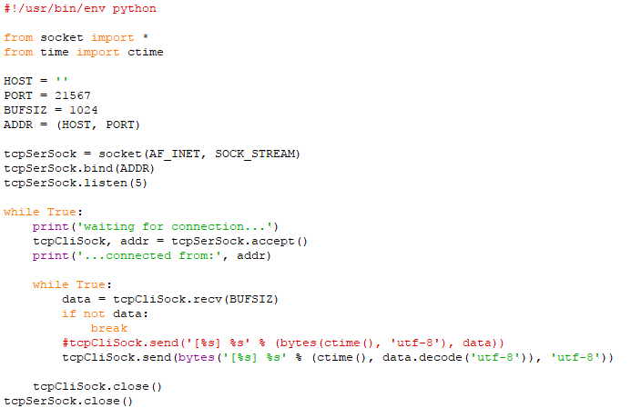
Example: TCP Timestamp Server (tsTserv3.py)
TCP server program that takes the data string sent from a client and returns it timestamped back to the client.
Notes:
#!/usr/bin/env python
from socket import *
from time import ctime
HOST = ''
PORT = 21567
BUFSIZ = 1024
ADDR = (HOST, PORT)
tcpSerSock = socket(AF_INET, SOCK_STREAM)
tcpSerSock.bind(ADDR)
tcpSerSock.listen(5)
while True:
print('waiting for connection...')
tcpCliSock, addr = tcpSerSock.accept()
print('...connected from:', addr)
while True:
data = tcpCliSock.recv(BUFSIZ)
if not data:
break
#tcpCliSock.send('[%s] %s' % (bytes(ctime(), 'utf-8'), data))
tcpCliSock.send(bytes('[%s] %s' % (ctime(), data.decode('utf-8')), 'utf-8'))
tcpCliSock.close()
tcpSerSock.close()
Lines 1–4
After the Unix start-up line, we import time.ctime() and all the attributes
from the socket module.
Lines 6–13
The HOST variable is blank, which is an indication to the bind() method
that it can use any available address. We also choose a random port number,
which does not appear to be used or reserved by the system. For our
application, we set the buffer size to 1K. You can vary this size based on
your networking capability and application needs. The argument for the
listen() method is simply a maximum number of incoming connection
requests to accept before connections are turned away or refused.
The TCP server socket (tcpSerSock) is allocated on line 11, followed by the
calls to bind the socket to the server’s address and to start the TCP listener.
Lines 15–28
Once we are inside the server’s infinite loop, we (passively) wait for a connection.
When one comes in, we enter the dialog loop where we wait for
the client to send its message. If the message is blank, that means that the
client has quit, so we would break from the dialog loop, close the client
connection, and then go back to wait for another client. If we did get a
message from the client, we format and return the same data but prepend
it with the current timestamp. The final line is never executed; it is there as
a reminder to the reader that a close() call should be made if a handler is
written to allow for a more graceful exit, as we discussed earlier.

Slide 23

Creating a TCP Client
All sockets are created by using socket.socket().
Client can immediately make a connection to a server by using the socket’s connect() method.
Then, the client can participate in a dialog with the server.
At the end, the client can close its socket, terminating the connection.

Slide 24
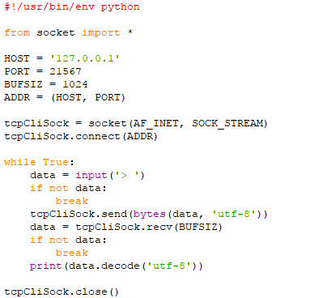
TCP Timestamp Client (tsTclnt3.py)
Notes:
#!/usr/bin/env python
from socket import *
HOST = '127.0.0.1'
PORT = 21567
BUFSIZ = 1024
ADDR = (HOST, PORT)
tcpCliSock = socket(AF_INET, SOCK_STREAM)
tcpCliSock.connect(ADDR)
while True:
data = input('> ')
if not data:
break
tcpCliSock.send(bytes(data, 'utf-8'))
data = tcpCliSock.recv(BUFSIZ)
if not data:
break
print(data.decode('utf-8'))
tcpCliSock.close()
Lines 5–11
The HOST and PORT variables refer to the server’s hostname and port number.
Because we are running our test (in this case) on the same computer,
HOST contains the local hostname (change it accordingly if you are running
your server on a different host). The port number PORT should be exactly
the same as what you set for your server (otherwise, there won’t be much
communication). We also choose the same 1K buffer size.
The TCP client socket (tcpCliSock) is allocated in line 10, followed by
(an active) call to connect to the server.
Lines 13–23
The client also has an infinite loop, but it is not meant to run forever like
the server’s loop. The client loop will exit on either of two conditions: the
user enters no input (lines 14–16), or the server somehow quit and our call
to the recv() method fails (lines 18–20). Otherwise, in a normal situation,
the user enters in some string data, which is sent to the server for processing.
The newly timestamped input string is then received and displayed to
the screen.

Slide 25
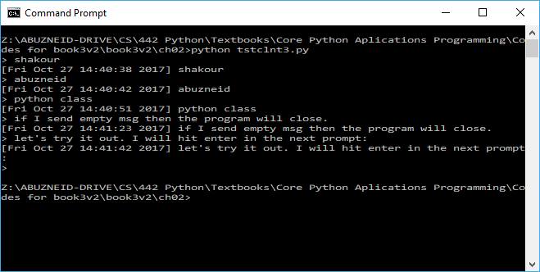
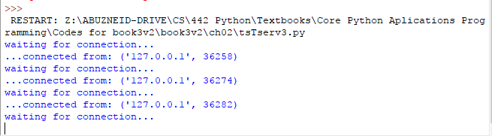
Executing Our TCP Server and Client(s)
The server is considered a passive partner because it has to establish itself first and passively wait for a connection.
The client is an active partner because it actively initiates a connection.

Slide 26

Creating a UDP Server
One other significant difference between UDP and TCP servers is that because datagram sockets are connectionless, there is no “handing off” of a client connection to a separate socket for succeeding communication.

Slide 27
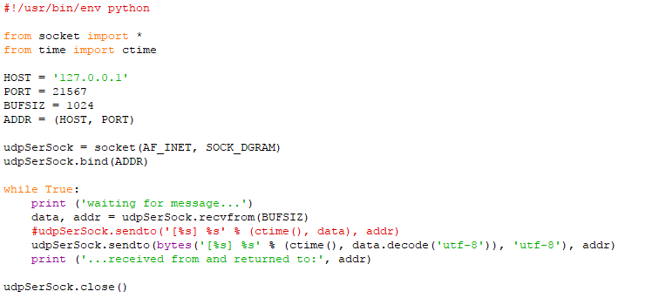
UDP Timestamp Server (tsUserv3.py)
Notes:
#!/usr/bin/env python
from socket import *
from time import ctime
HOST = '127.0.0.1'
PORT = 21567
BUFSIZ = 1024
ADDR = (HOST, PORT)
udpSerSock = socket(AF_INET, SOCK_DGRAM)
udpSerSock.bind(ADDR)
while True:
print ('waiting for message...')
data, addr = udpSerSock.recvfrom(BUFSIZ)
#udpSerSock.sendto('[%s] %s' % (ctime(), data), addr)
udpSerSock.sendto(bytes('[%s] %s' % (ctime(), data.decode('utf-8')), 'utf-8'), addr)
print ('...received from and returned to:', addr)
udpSerSock.close()
Lines 1–4
After the Unix startup line, we import time.ctime() and all the attributes
from the socket module, just like the TCP server setup.
Lines 6–12
The HOST and PORT variables are the same as before, and for all the same
reasons. The call socket() differs only in that we are now requesting a
datagram/UDP socket type, but bind() is invoked in the same way as in
the TCP server version. Again, because UDP is connectionless, no call to
“listen for incoming connections” is made here.
Lines 14–21
Once we are inside the server’s infinite loop, we (passively) wait for a message
(a datagram). When one comes in, we process it (by adding a timestamp
to it), then send it right back and go back to wait for another message.
The socket close() method is there for show only, as indicated before.

Slide 28
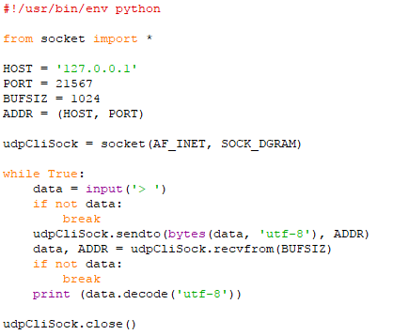
UDP Timestamp Client (tsUclnt3.py)
Notes:
#!/usr/bin/env python
from socket import *
HOST = '127.0.0.1'
PORT = 21567
BUFSIZ = 1024
ADDR = (HOST, PORT)
udpCliSock = socket(AF_INET, SOCK_DGRAM)
while True:
data = input('> ')
if not data:
break
udpCliSock.sendto(bytes(data, 'utf-8'), ADDR)
data, ADDR = udpCliSock.recvfrom(BUFSIZ)
if not data:
break
print (data.decode('utf-8'))
udpCliSock.close()
Lines 1–3
After the Unix startup line, we import all the attributes from the socket
module, again, just like in the TCP version of the client.
Lines 5–10
Because we are running the server on our local computer again, we use
“localhost” and the same port number on the client side, not to mention
the same 1K buffer. We allocate our socket object in the same way as the
UDP server.
Lines 12–22
Our UDP client loop works in almost the exact manner as the TCP client.
The only difference is that we do not have to establish a connection to the
UDP server first; we simply send a message to it and await the reply. After
the timestamped string is returned, we display it to the screen and go back
for more. When the input is complete, we break out of the loop and close
the socket.

Slide 29
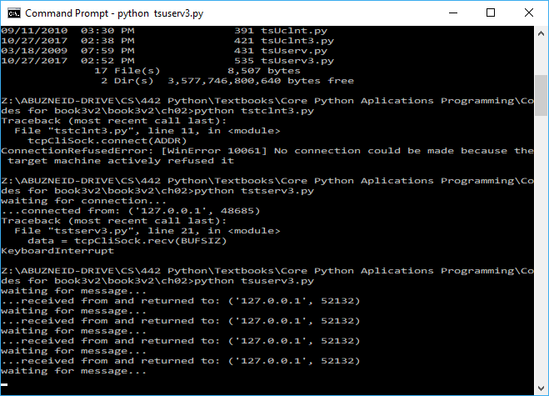
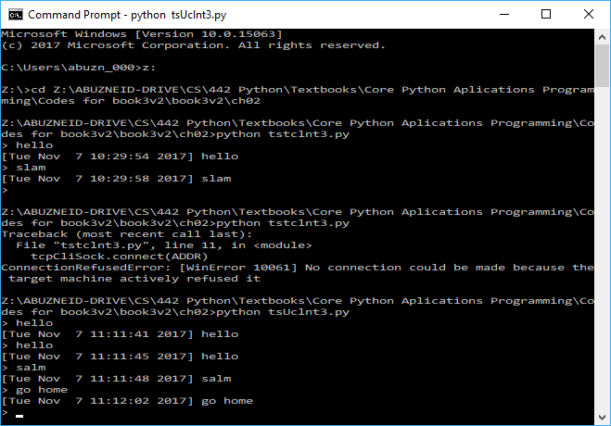
Output

Slide 30
socket Module Attributes

Slide 31
socket Module Attributes

Slide 32
socket Module Attributes

Slide 33
The socketserver Module
socketserver is a higher-level module in the standard library.
Simplifies a lot of code that is necessary to create networked clients and servers.
Several classes created on your behalf.

Slide 34
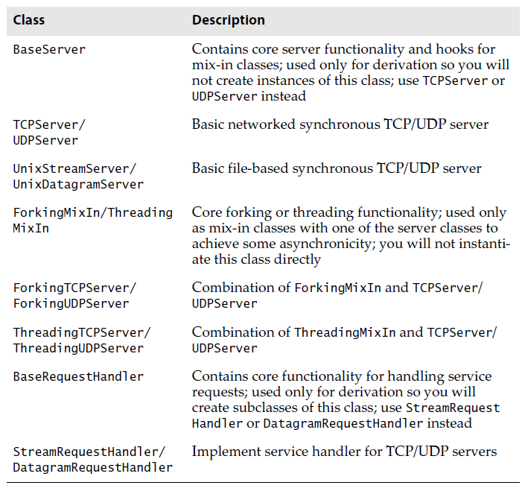
socketserver Module Classes

Slide 35
Advantages of socketserver over socket
Simpler code by hiding implementation details from you.
Writing our applications using classes which helps us organize our data and logically direct functionality to the right places.
event-driven Applications, meaning that they only work when reacting to an occurrence of an event in our system.
Events include the sending and receiving of messages.
Class definition only consists of an event handler for receiving a client message. All other functionality is taken from the socketserver classes we use.
Final line of our code is usually a server’s infinite loop waiting for and responding to client service requests.

Slide 36
Creating a socketserver TCP Server
In our original server loop, we block waiting for a request, service it when something comes in, and then go back to waiting.
In the server loop here, instead of building your code in the server, you define a handler so that the server can just call your function when it receives an incoming request.

Slide 37
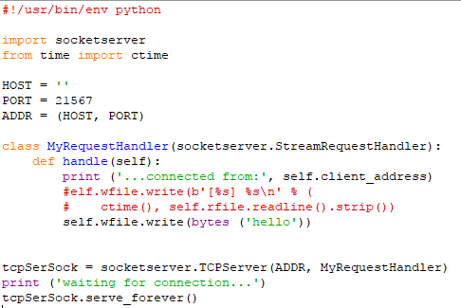
socketserver Timestamp TCP Server (tsTservSS.py)
Notes:
#----- cut code here ----
#!/usr/bin/env python
import socketserver
from time import ctime
HOST = ''
PORT = 21567
ADDR = (HOST, PORT)
class MyRequestHandler(socketserver.StreamRequestHandler):
def handle(self):
print ('...connected from:', self.client_address)
#elf.wfile.write(b'[%s] %s\n' % (
# ctime(), self.rfile.readline().strip())
self.wfile.write(bytes ('hello'))
tcpSerSock = socketserver.TCPServer(ADDR, MyRequestHandler)
print ('waiting for connection...')
tcpSerSock.serve_forever()
#----- end code here ---
Lines 1–9
The initial stuff consists of importing the right classes from SocketServer.
Lines 11–15
The bulk of the work happens here. We derive our request handler MyRequestHandler as a subclass of SocketServer’s StreamRequestHandler and override
its handle() method, which is stubbed out in the Base Request class with no default action as:
def handle(self):
pass
The handle() method is called when an incoming message is received from a client. The StreamRequestHandler class treats input and output
sockets as file-like objects, so we will use readline() to get the client message and write() to send a string back to the client.
Accordingly, we need additional carriage return and NEWLINE characters in both the client and server code. Actually, you will not see it in the code because we are just reusing those which come from the client. Other than these minor differences, it should look just like our earlier server.
Lines 17–19
The final bits of code create the TCP server with the given host information and request handler class. We then have our entire infinite loop waiting for and servicing client requests.

Slide 38
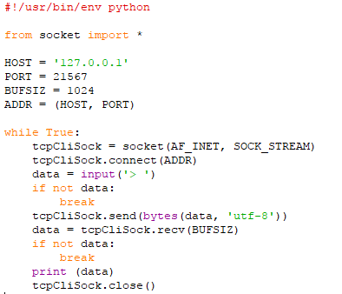
Creating a socketserver TCP Client
Notes:
#--- cut code here ----
#!/usr/bin/env python
from socket import *
HOST = '127.0.0.1'
PORT = 21567
BUFSIZ = 1024
ADDR = (HOST, PORT)
while True:
tcpCliSock = socket(AF_INET, SOCK_STREAM)
tcpCliSock.connect(ADDR)
data = input('> ')
if not data:
break
tcpCliSock.send(bytes(data, 'utf-8'))
data = tcpCliSock.recv(BUFSIZ)
if not data:
break
print (data)
tcpCliSock.close()
#---- end code here ----
This is a timestamp TCP client that knows how to speak to the file-like Socket Server class StreamRequestHandler objects.
Lines 1–8
Nothing special here; this is an exact replica of our original client code.
Lines 10–21
The default behavior of the SocketServer request handlers is to accept a connection, get the request, and then close the connection. This makes it so that we cannot keep our connection throughout the execution of our
application, so we need to create a new socket each time we send a message to the server.
This behavior makes the TCP server act more like a UDP server; however, this can be changed by overriding the appropriate methods in our request handler classes. Other than the fact that our client is somewhat “inside-out” now (because we have to create a connection each time), the only other minor difference was previewed in the line-by-line explanation for the server code: the handler class we are using treats socket communication like a file, so we have to send line-termination characters (carriage return and NEWLINE) each way. The server just retains and reuses the ones we send here. When we get a message back from the server, we strip() them and just use the NEWLINE that is automatically provided by the print statement.

Slide 39
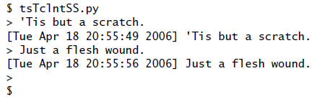

Executing our TCP Server and Client(s)
Here is the output of our socketserver TCP client:
And here is the server’s output:
The output is similar to that of our original TCP client and servers; however, you will notice that we connected to the server twice.

Slide 40
Introduction to the Twisted Framework
Twisted is a complete event-driven networking framework.
Used for asynchronous networked applications and protocols.
It is not part of the Python Standard Library.
Download: http://twistedmatrix.com/
Twisted provides a much more powerful and flexible framework and has implemented many protocols for you already.
It provides a significant amount of support for you to build complete systems, including network protocols, threading, security and authentication, chat/IM, DBM and RDBMS database integration, Web/Internet, e-mail, command-line arguments, GUI toolkit integration, etc.
Like socketserver, most of the functionality of Twisted lies in its classes.

Slide 41
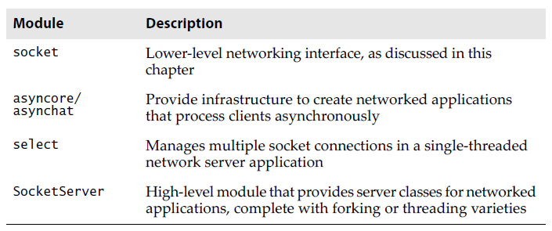
Network/Socket Programming Related Modules

Slide 42
select module
Used in conjunction with the socket module when developing lower-level socket applications.
Provides the select() function, which manages sets of socket objects.
One of the most useful things it does is to take a set of sockets and listen for active connections on them.
The select() function will block until at least one socket is ready for communication, and when that happens, it provides you with a set of those that are ready for reading.

Slide 43
async* and socketserver modules
Provide higher-level functionality.
Written on top of the socket and/or select modules, they enable more rapid development of client/server systems because all the lower-level code is handled for you.
socketserver even provides the capability of integrating threading or new processes into the server, which affords a more parallel-like processing of client requests.
async* provides the only asynchronous development support in the standard library.

Slide 44
Concurrence
Concurrence is modern networking framework.
The engine behind the Dutch social network, Hyves.
Concurrence is a high-performance I/O system paired with libevent, the lower-level event callback dispatching system.
Concurrence follows an asynchronous model, using lightweight threads (executing callbacks) in an event-driven way to do the work and message-passing for interthread communication.
More info about Concurrence at: http://opensource.hyves.org/concurrence
Notes:
Hyves was a social networking site in the Netherlands with mainly Dutch visitors and members, where it competed with sites such as Facebook and MySpace. Hyves was founded in 2004 by Raymond Spanjar and Floris Rost van Tonningen. The service was available in both Dutch and English. https://en.wikipedia.org/wiki/Hyves

Slide 45
Modern networking frameworks
Follow one of many asynchronous models (greenlets, generators, etc.) to provide high-performance asynchronous servers.
One of the goals of these frameworks is to push the complexity of asynchronous programming so as to allow users to code in a more familiar, synchronous manner.

Slide 46
References
Core Python Applications Programming, 3rd Edition by Wesley J. Chun, Prentice Hall.
https://pythonprogramming.net/urllib-tutorial-python-3/
Socket Programming in Python (Guide) https://realpython.com/python-sockets/#background
socket — Low-level networking interfacehttps://docs.python.org/3/library/socket.html

